Slide 1
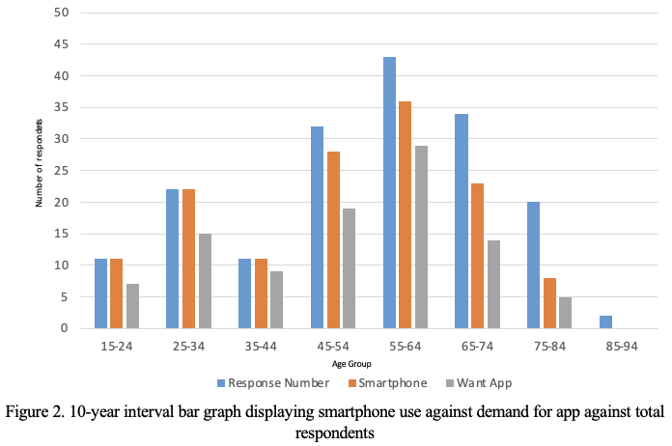
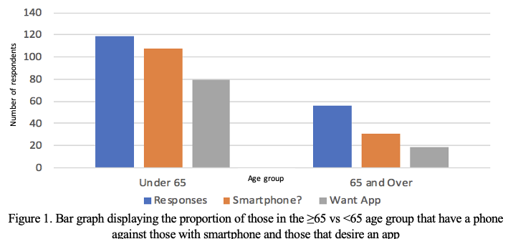
Establishing digital literacy levels in the pre-operative cohort in relation to Mobile Health (mHealth) and the future implementation of an application (app) for pre-operative patients.
C.Short¹ , V. Taylor-Jones², D.Robinson³
1. Aintree University Hospital NHS Trust Pre-Operative Assessment Clinic
Rationale
MHealth is an established, effective method of improving patient outcomes in areas of mental health, chronic disease and lifestyle. Digital literacy, required to effectively access and utilise this information, is shown to be lower in the elderly population [1]. This is further compounded by lack of access to devices as well poor connectivity. [2]
Our main aim was to establish whether an app navigating patients through their pre-operative journey, would be accessed by the study cohort. Preparing for an mHealth platform designed to improve patient care and satisfaction, through delivering information on pre-habilitation, nutrition, fit for surgery, fasting, medication and recovery. The first stage was to assess the digital literacy of the pre-operative patient cohort at Aintree University Hospital NHS Trust using a prospective study model.
Methods
A questionnaire containing both dichotomous and multiple-choice questions was conducted in the Pre-Operative Assessment Clinic between July and November 2019.
Data included age, mobile device use, device type, smartphone use, functional use including apps and a desire for a pre-operative mobile app.
No exclusion criteria.
No funding was required for this project.
Audit department approval was sought.
Conclusions
The use of an app may have some effect in ≥65’s but is limited in extremes of age, for example those aged >85.
Findings were in keeping with previous research of significantly lower digital literacy in the ≥65 age group when compared to the <65 [1].
The peak demand for an app was in the age range 35-44.
COVID 19 has shifted care in the direction of mHealth and apps highlighting the need for alternative sources and points of care as age increases.
To further demonstrate demand, a larger study obtaining significant data for 5 and 10 year intervals (Fig 2) would be required.
This efficacy in extremes of age is to be expected, however, as more digitally literate people advance in age it is likely the efficacy in older people will increase in line with this and repeat studies to demonstrate this would be useful.
Results
Of 175 respondents 139 used a smartphone device and 56% (n=175) indicated that an app would be useful. The 56 patients (age ≥65) were classed as elderly, 55.4% (n=56) of whom used a smartphone and 33.9% (n=56) (95% CI 32.7-35.1) would use an app (Fig 1). Of the 119 patients aged <65, 90.8% (n=119) indicated use of a smartphone, 80.6% (n=119) (95% CI 76.3-84.9) indicating an app would be useful. No patient aged >85 indicated need for an app or smartphone use.
References
1. Ivan Watkins and Bo Xie. eHealth Literacy Interventions for Older Adults: A Systematic Review of the Literature. Journal of Medical Internet Research. 2014 Nov; 16(11): e225
2. Malcolm Fisk, Anne Livingstone and Sabrina Winona, Telehealth in the Context of COVID-19: Changing Perspectives in Australia, the United Kingdom, and the United States. 2020 June; 22(6): e19264.

